Slide 1
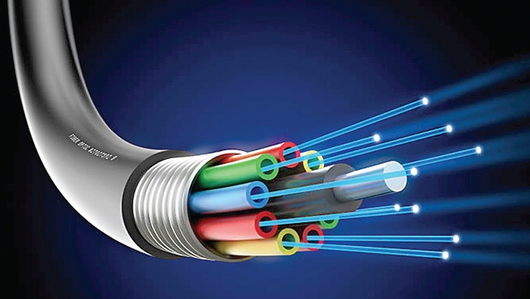
Topic: Optical Fiber

Slide 2
Subrata Kumer Paul
3rd year 1st Semester.
Session: 2012-13
Roll: 13015411
Dept. of Computer Science
and Engineering
Rajshahi University

Slide 3
Brief flow of presentation
Introduction
What are Optical Fibers?
Evolution of optical fiber
Structure of optical fiber
Workings principle of optical fiber
Classification of optical fiber
Optical fiber communication system
Why it is Emerging Technology
Advantages / Disadvantages of Optical fiber
Optical fiber Company List
Optical fiber Testing
Optical fiber vendor and Price in Bangladesh
Applications of Optical fiber
Conclusion

Slide 4
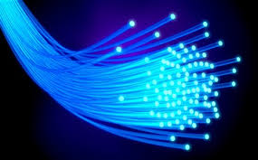
What is optical Fiber?
Fiber optic (or "optical fiber") one kind of technology that associated with the transmission of information(data) as light impulses along a glass or plastic wire or fiber.
Optical fibers use light to send information through the optical medium.

Slide 5
Evolution of optical fiber
1880 – Alexander Graham Bell
1930 – Patents on tubing
1950 – Patent for two-layer glass wave-guide
1960 – Laser first used as light source
1965 – High loss of light discovered
1970s – Refining of manufacturing process(John Tyndall demonstration in 1970s)
1980s – OF technology becomes backbone of long distance telephone networks in NA.

Slide 6
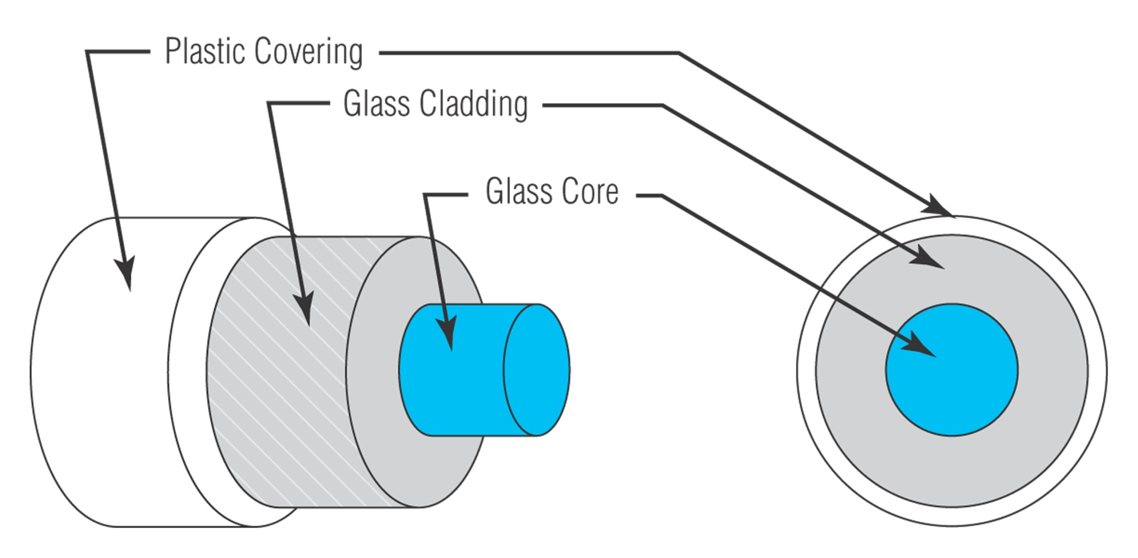
Structure of optical fiber

Slide 7
Glass Core – central tube of very thin size made up of optically transparent dielectric medium and carries the light form transmitter to receiver. The core diameter can vary from about 5um to 100 um.
Glass Cladding – outer optical material surrounding the core having reflecting index lower than core. It helps to keep the light within the core throughout the phenomena of total internal reflection.
Plastic Covering– plastic coating that protects
the fiber made of silicon rubber. The typical diameter of fiber after coating is 250-300 um.
* m=micrometer (American spelling)(1×10⁻⁶meter)

Slide 8
Working principle
Total Internal Reflection
When a ray of light travels from a denser to a rarer medium such that the angle of incidence is greater than the critical angle, the ray reflects back into the same medium this phenomena is called total internal reflection.
In the optical fiber the rays undergo repeated total number of reflections until it emerges out of the other end of the fiber, even if the fiber is bent.

Slide 9
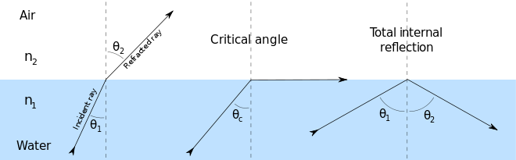
Total internal reflection in optical fiber

Slide 10
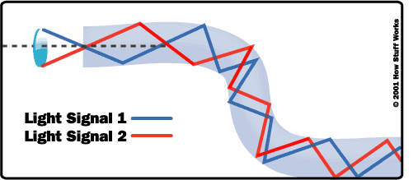
Total internal reflection in optical fiber

Slide 11
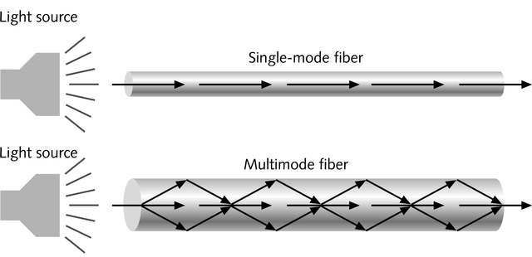
Classification of optical fiber
on the basis of number of modes of propagation the optical fiber are classified into two types:
Single mode fiber (SMF) and
Multi-mode fiber (MMF)

Slide 12
Single-mode fiber
Carries light pulses along single path
Uses Laser Light Source
has a very small core and carry only one beam of light. It can support (Gbps) data rates over > 100 Km without using repeaters.
data rates up to 10 Gbps with a bandwidth of 20Ghz.
Multimode fiber
Many pulses of light generated by LED travel at different angles
can support less bandwidth than Single-mode Fiber.
data rates up to 1 Gbps.

Slide 13
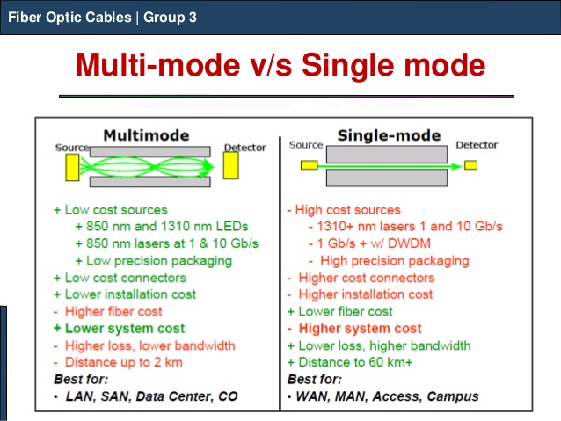

Slide 14
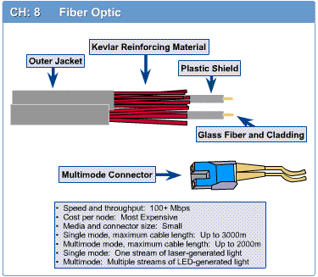
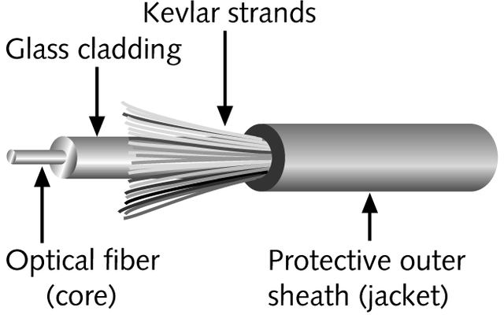
Fiber-Optic Cable
Contains one or several glass fibers at its core
Surrounding the fibers is a layer called cladding

Slide 15
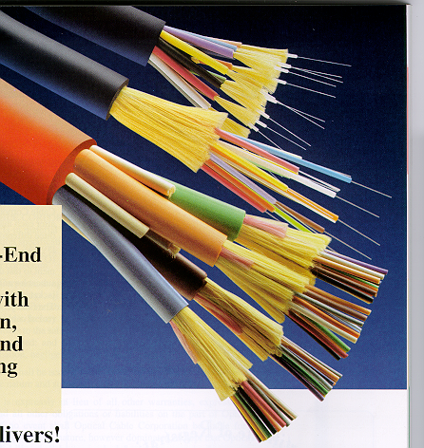
Fiber Optic Cable
FO Cable may have 1 to over 1000 fibers

Slide 16
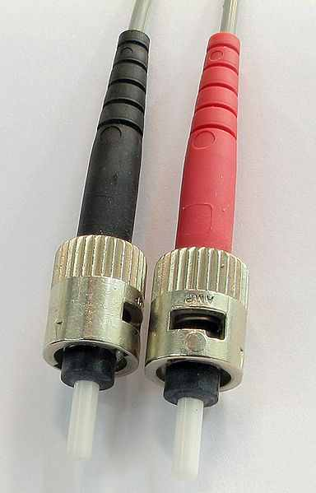
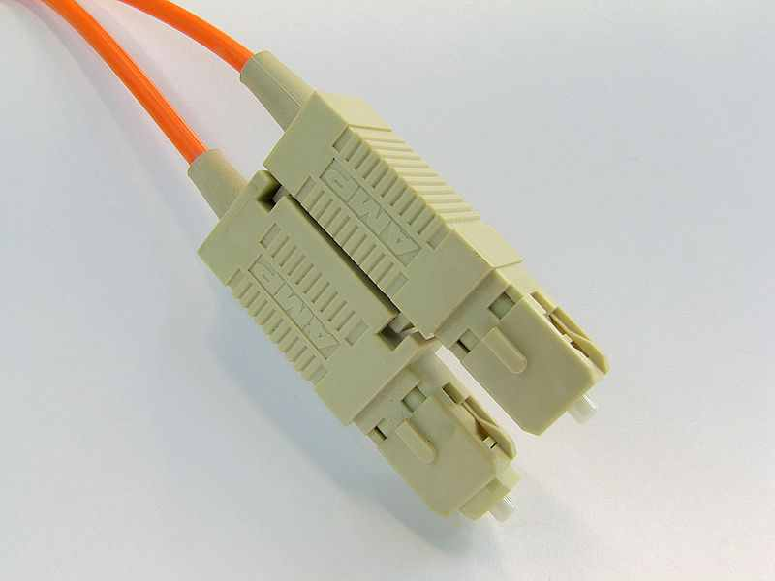
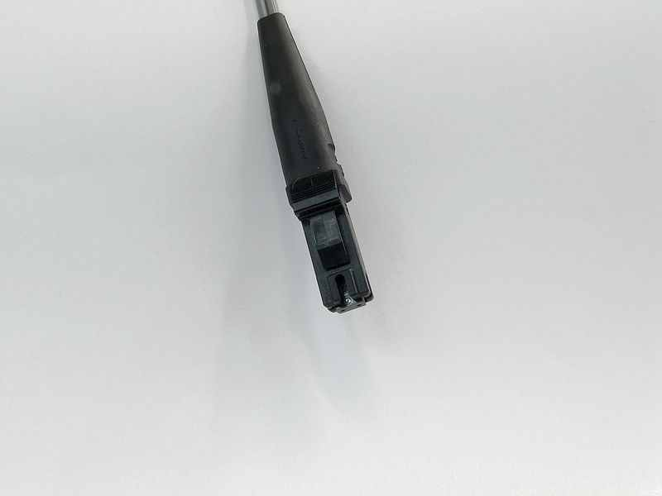
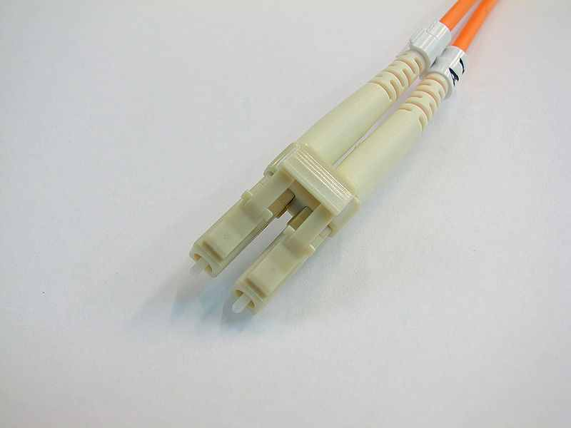
Fiber-Optic Cable (Connectors)
SC-(Square Connector)
ST-(straight tip)
MT-RJ (Mechanical Transfer Registered Jack or Media Termination - recommended jack)
LC-(Lucent Connector, Little Connector, or
Local Connector)

Slide 17
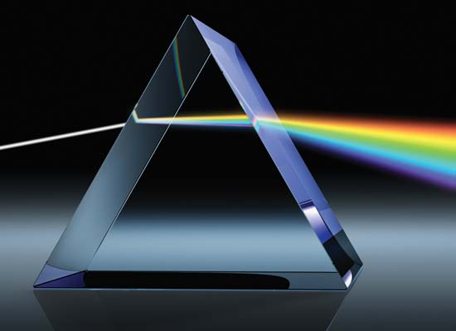
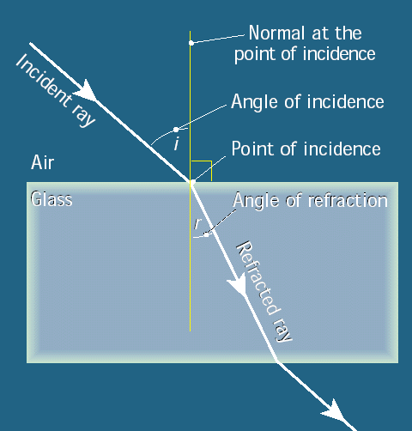
Refraction
Refraction is the most basic concept for Optical fiber. It changes the direction of light when it goes into a material of different density

Slide 18
How Optical Fiber’s are made??
Three Steps are Involved in the manufacturing of the optical fiber which are given below:-
-Making a Preform Glass Cylinder
-Drawing the Fiber’s from the preform
-Testing the Fiber.

Slide 19
Optical Fiber Communication System
Information source
Electrical source
Optical source
Optical fiber cable
Optical detector
Electrical receive
Destination

Slide 20
Information source- it provides an electrical signal to a transmitter comprising an electrical stage.
Electrical source- It drives an optical source to give an modulation of the light wave carrier.
Optical source- It provides the electrical-optical conversion .It may be a semiconductor laser or an LED.

Slide 21
Optical cable: It serves as transmission medium.
Optical detector: It is responsible for optical to electrical conversion of data and hence responsible for demodulation of the optical carrier. It may be a photodiodes, phototransistor, and photoconductors.
Electrical receiver: It is used for electrical interfacing at the receiver end of the optical link and to perform the signal processing electrically.
Destination: It is the final point at which we receive the information in the form of electrical signal.

Slide 22
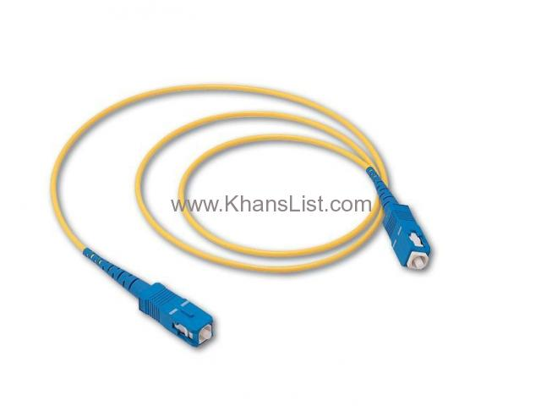
Source: http://khanslist.com/electronics_2/computer-accessories/digital-fiber-optic-cable-5miter_i6746
FO Cable Price in Bangladesh
Fiber Optic Cable with Multimode , High Reliability supplier
Digital Fiber Optic Cable 5MITER
Price 200.00 Taka
(2.56 USD)

Slide 23
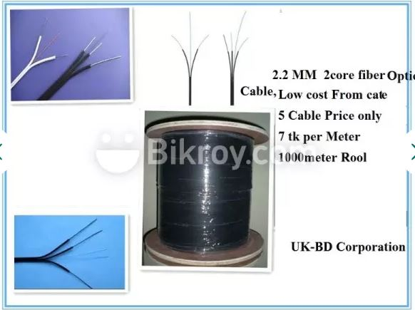
FO Cable Price in Bangladesh
fiber optic cable 2 core 2.2 mm
7 taka per Meter

Slide 24

Optical fiber company in Bangladesh (Vendors)

Slide 25
Advantage of optical fiber communication
The life of fiber is longer than copper wire
Handling and installation costs of optical fiber is very nominal
It is unaffected with electromagnetic interference
Attenuation in optical fiber is lower than coaxial cable or twisted pair.
There is no necessity of additional equipment for protecting against grounding and voltage problems.
As it does not radiates energy any antenna or detector cannot detects it hence provides signal security

Slide 26
Disadvantage
Highly skilled staff would be required for maintenance
Only point to point working is possible on optical fiber
Precise and costly instruments would be required
Costly if under utilized.
Accept unipolar codes only.
Jointing of fiber and splicing is also time consuming.

Slide 27
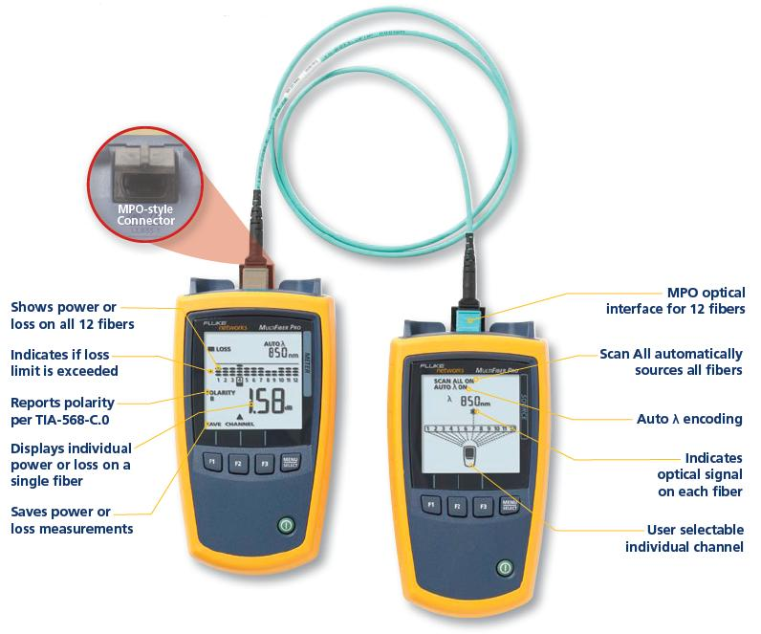
Testing Fiber Cables
Notes:
4.2.3.5 Testing Fiber Cables

Slide 28
Applications
Optical fiber have wider range of application in almost all field, some are been specified below
In telecommunication field
In space applications
Broadband applications
Computer applications industrial applications
Mining applications
In medical applications
In military applications etc.

Slide 29
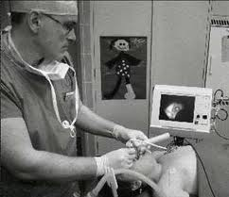
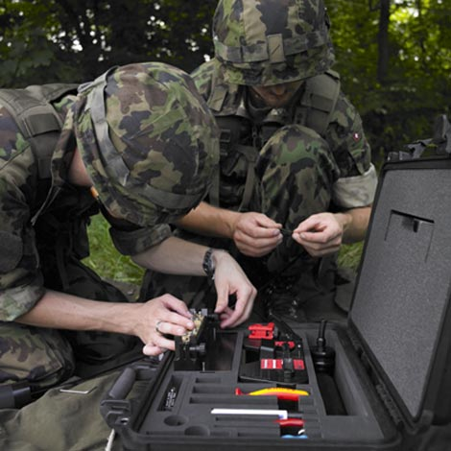
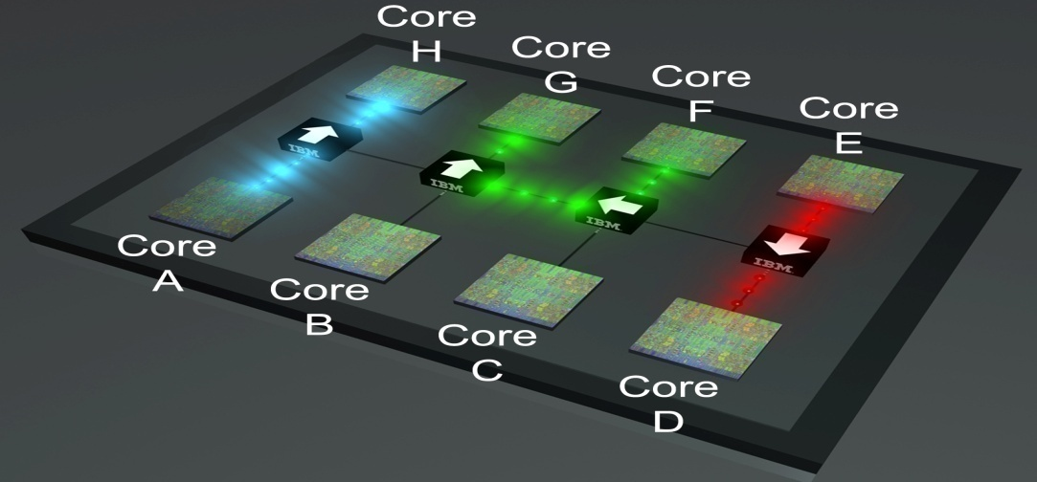
Optical fiber have wider range of application in almost all field, i.e. in medical, electronics, military etc .some are been specified below
Medical Military
Electronics
IBM microprocessors

Slide 30
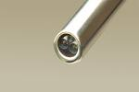
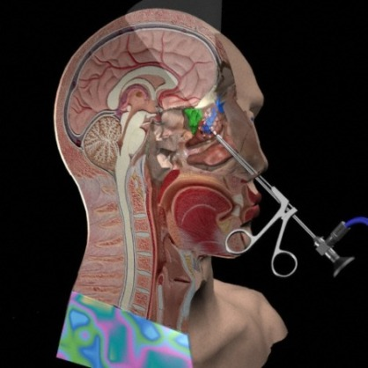
The Endoscope
There are two optical fibres
One for light, to illuminate the inside of the patient
One for a camera to send the images back to the doctor.
Key hole surgery

Slide 31
Conclusion
This conclusion our study of optical fiber communications have looked at how they work and how they are made, properties of fibers, Application...
Although this presentation does not cover all the aspects of optical fiber work it will have equipped you knowledge and skills essential to the fiber optic industry.

Slide 32

References(1)
https://en.wikipedia.org/wiki/Optical_fiber
http://electronics.howstuffworks.com/fiber-optic7.htm
http://www.commspecial.com/fiberguide.htm
http://www.thefoa.org/
http://www.fiber-optics.info/fiber-history.htm
http://www.timbercon.com/history-of-fiber-optics/

Slide 33
References(2)
http://www.radio-electronics.com/info/telecommunications_networks/fiber-fibre-optics/communications-basics-tutorial.phphttp://electronics.howstuffworks.com/fiber-optic7.htm
http://fios.verizon.com/beacon/how-fiber-optic-internet-works/
http://www.fiber-optics.info/fiber-history.htm
http://www.alibaba.com/countrysearch/BD/fiber-optic-price-supplier.html

Slide 34
THANK YOU

